Slide 1
Welcome to
DoubleClick
Night Agency | March 31, 2008
© 2007 DoubleClick Inc. All Rights Reserved.

Slide 2
Welcome to DoubleClick – Call Agenda
Introduction
  Your GTS team
DART for Advertisers® (DFA)
  TAM Services
  Contact Information
  Next Steps
Customer Resource Center
  Help!
  Learn Center
© 2007 DoubleClick Inc. All Rights Reserved.

Slide 3
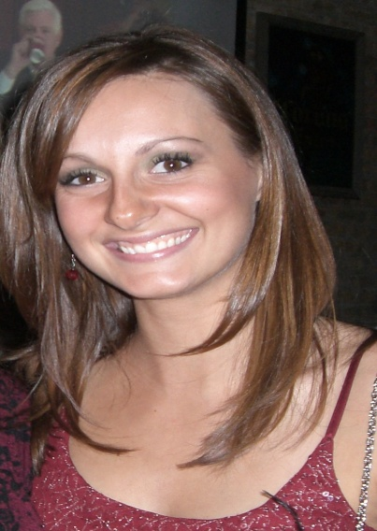
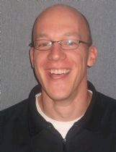
Your DART for Advertisers® GTS Team
Shawn White
Director, Advertising Services
Thornton, CO
shwhite@doubleclick.com
(303) 729-3295
Mandy Kaatz
Technical Account Manager
Thornton, CO
akaatz@doubleclick.com
(312) 739.0382
Ensures proper services delivery to all DFA clients and the point of escalation
Your day to day partner to help you best utilize DFA
© 2007 DoubleClick Inc. All Rights Reserved.

Slide 4
What is GTS?
Global Technical Services
The people:
We are a team of 400+ people based across the globe
  NA DART Search team - 20+ members
  NA DFA team - 30+ members
Focused entirely on delivering excellent services
to enable your success
© 2007 DoubleClick Inc. All Rights Reserved.
Notes:
Do we want to keep these team numbers or update?

Slide 5
GTS: services
Global Technical Services
The process:
Mature services processes
  ‘Follow the sun services’
  clearly defined process within DoubleClick teams
Service infrastructure
  Customer Resource Center
  Knowledge Base
© 2007 DoubleClick Inc. All Rights Reserved.

Slide 6
DART for Advertisers®
Technical Account Managers
© 2007 DoubleClick Inc. All Rights Reserved.

Slide 7
What is the Technical Account Managers (TAM) Role?
Getting Started:
Coordinates training needs with both DFA and MV (classroom/in-house training, CMC visits…)
Day-to-day contact for 'How to…' type questions. Trains you to learn how to traffic, optimize, pull reports, and to best understand your campaign performance in DFA.
Helps you use MediaVisor to plan upcoming campaigns and port them into DFA
Offers best practices for Spotlight tags
© 2007 DoubleClick Inc. All Rights Reserved.

Slide 8
TAM Role: We’re up and running, now what?
Your day-to-day operational contact; a natural extension of your marketing and media planning teams
Serves as an escalation point regarding DFA Support or Trafficking cases
Assists to identify areas of need and coordinate resources; Advanced Reports, Data Transfer, Boomerang or Custom Reports
Informs and trains you on new product releases and relevant feature updates
Responsible for sharing “Best Practices” principles as it relates to your campaigns
© 2007 DoubleClick Inc. All Rights Reserved.

Slide 9
Contacting Technical Support
Log a support case to be routed directly to Technical Support
Online: http://help.doubleclick.com
  E-mail: dfa@support.doubleclick.com
  Tel: 1-877-376-DART (3278)
  In addition, our Global Support team is available to respond to critical support tickets
  See the support handbook for more information at http://kb.doubleclick.com - ‘Global Support Handbook’
© 2007 DoubleClick Inc. All Rights Reserved.

Slide 10
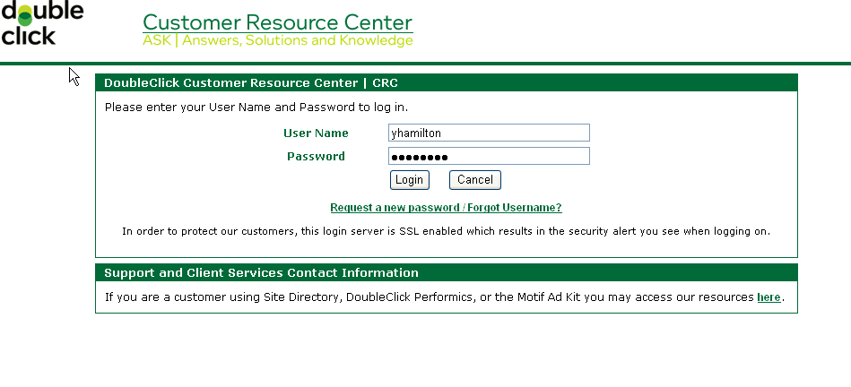
CRC Login
Please note the User Name and Password is not the same as your Dart for Advertisers (DFA) User Name and Password. If you are a new user select “new password/forgot username”. If you need a DFA User Name and Password please contact your Technical Account Manager.
© 2007 DoubleClick Inc. All Rights Reserved.

Slide 11
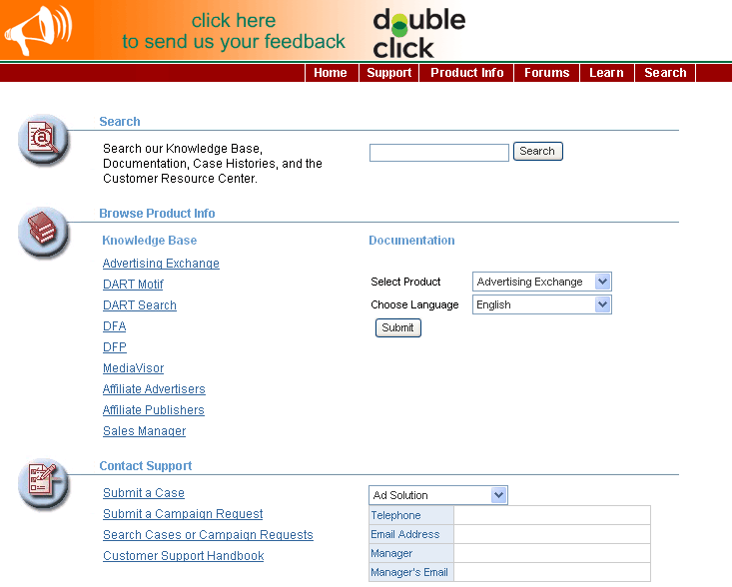
Help at DoubleClick
http://help.doubleclick.com
Documentation and FAQs
Log a support ticket
© 2007 DoubleClick Inc. All Rights Reserved.
Notes:
From here, you can:
ID what KB you are using
Browse all KB’s
Search one of 3 ways
Keywords
Natural Language (type in entire question)
Article ID
View most popular articles (Hot Topics)

Slide 12
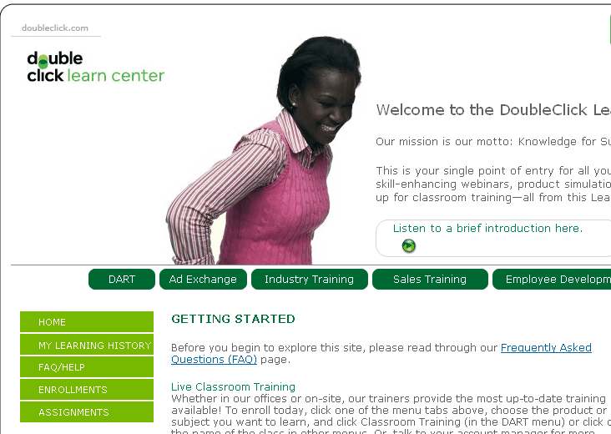
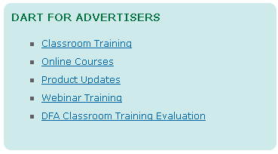
DoubleClick Learn Center
Access directly at:
http://learn.doubleclick.com
© 2007 DoubleClick Inc. All Rights Reserved.

Slide 13

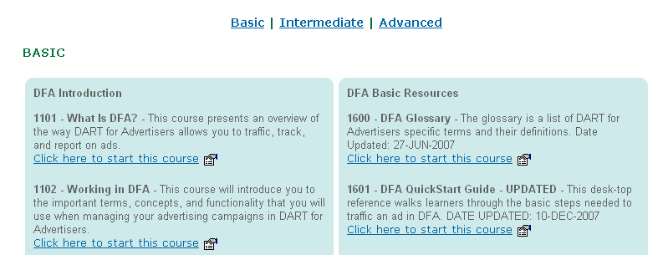
Q & A
© 2007 DoubleClick Inc. All Rights Reserved.

Slide 14
Next Steps…
Gather contact information for DFA and CRC logins
Set-up trainings (classrooms, webinars, on-site)
Discuss:
  First campaign
  Spotlight/Floodlight
  Reporting requirements
  Creative types
© 2007 DoubleClick Inc. All Rights Reserved.

